Slide 1

CMPT 506
Indexing
Read Chapter 18 and Chapter 17 (pages 611 to 621)

Slide 2



Outline
Introduction
Tree Based Indexes
Hash Indexes
Notes:
Types of index
Clustered vs. Unclustered
Dense vs. Sparse
Data Structures
Hash based indexing
Tree based indexing
set statistics io on
SQL - 8K pages
exec sp_helpindex tableName

Slide 3

Introduction to Indexes

Slide 4
Types of Queries
Point Query SELECT balance FROM accounts WHERE number = 1023;
Multipoint Query SELECT balance FROM accounts WHERE branchNum = 100;
Ordering Query SELECT * FROM accounts ORDER BY balance;
Range Query SELECT number FROM accounts WHERE balance > 10000 and balance <= 20000;
Prefix Match Query SELECT * FROM employees WHERE name like ‘J*’ ;
Notes:
Scan Query
select sum(long) from employees;
Extremal Query
SELECT * FROM accounts WHERE balance = max(select balance from accounts)
Grouping Query SELECT branchnum, avg(balance) FROM accounts GROUP BY branchnum;
Join Query SELECT distinct branch.adresse FROM accounts, branch WHERE accounts.branchnum = branch.number and accounts.balance > 10000;

Slide 5

Index
An index is a data structure that supports efficient access to data
Set of Records
Condition on attribute value
Matching records
index
(search key)
Think about the relative ease of finding a topic in a book by using the index, rather than by reading through the book from start to finish!

Slide 6
Indexes
An index is a data structure that organizes data to optimize the locating row(s) without having to scan entire table
An index supports efficient retrieval of records based on the search key of the index
A file can have more than one index – each based on a different search key
An index is a collection of data entries which must contain:
A search key value, k, and
Pointer to find data records with that search key value
Notes:
An index can be created for a file to speed up searches that are not efficiently supported by the file's organization
Index entries are stored in accordance with the search key value
Files can be indexed, to provide multiple ways to access records efficiently
Index files contain search key values and pointers to find data records with that search key value
•Mechanism for efficiently locating row(s) without having to scan entire table
•Based on a search key: rows having a particular value for the search key attributes can be quickly located

Slide 7
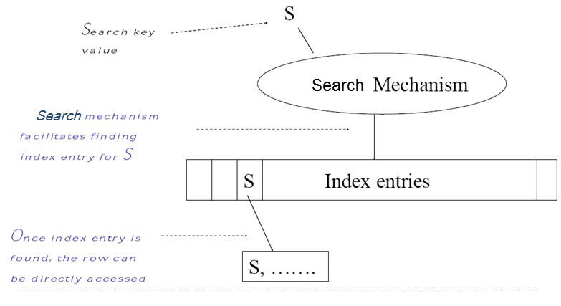
Index Structure
Notes:
–Index entries contains:
•Can contain the data tuple itself (index and table are integrated in this case); or
•Search key value and a pointer to a row having that value; table stored separately in this case –unclustered index
–Search mechanism
•Algorithm + data structure for locating an index entry with a given search key value
–Index entries are stored in accordance with the search key value
•Entries with the same search key value are stored together (hash, B-tree)
•Entries may be sorted on search key value (B-tree)

Slide 8
Indexes: Design Trade-off
Two important considerations in the design of indexing systems are:
The tradeoff between the computational gain from using the index and the computational cost of maintaining it when the table data is altered by an operation such as insert, update, or delete.
+ Additional I/O to access index pages (except if index is small enough to fit in main memory)
The extra disk space that the index structure requires
=> Longer to backup and restore
Notes:
Indexes take-up disk space
Index must be updated when table is modified.
Because each index needs to be maintained when the table is modified by an insert, delete, or update - and because index structures consume additional disk space - an index is created only when there is reason to believe that the performance gain from having it outweighs the cost of storing/maintaining it.

Slide 9
Clustered Index
Clustering Index = the actual data are stored in the order dictated by the index. In a non-clustering index, it is not.
It can defined on a Primary key or on a non-key field
Index defined on a Primary key field is called a Primary index
Implemented as a B-Tree data structure
Leaf nodes contain the data pages of the underlying table
There can only be one clustered index for a table
Clustered Index is good for range searches, ORDER BY or GROUP BY queries
because the index need only be used to locate the first row in the range, and then subsequent rows are found by following the physical order of the data.
E.g., CSE courses in QU catalog – lookup index to locate first page of CSE courses, then continue reading all the descriptions without needing to refer to the index again.
Notes:
It can defined on a key or on a non-key field
Index defined on a key field is called a primary index
Index defined on a key field is called a primary index
Clustered indexes can be either dense or sparse
Use location mechanism to locate index entry at start of range. This locates first row.
Subsequent rows are stored in successive locations (not so for unclustered index)
Minimizes page transfers and maximizes likelihood of cache hits
an index specified on the Sort key field of a sorted file of records.
An index on a sequential file
The search key of the index is the same as the sort key of the file
when a range of search key values is requested.
Primary indexes are also referred to as clustered
Clustered Index
Only one per table
Faster to read than non clustered as data is physically stored in index order
Non Clustered Index
Can have many per table
Quicker for insert and update operations than a clustered index
Both types of index will improve performance when select data with fields that use the index but will slow down update and insert operations.
Because of the slower insert and update clustered indexes should be set on a field that is normally incremental i.e. Id or Timestamp.
Good comparison @ http://sql-plsql.blogspot.in/2010/06/non-clustered-indexes.html

Slide 10
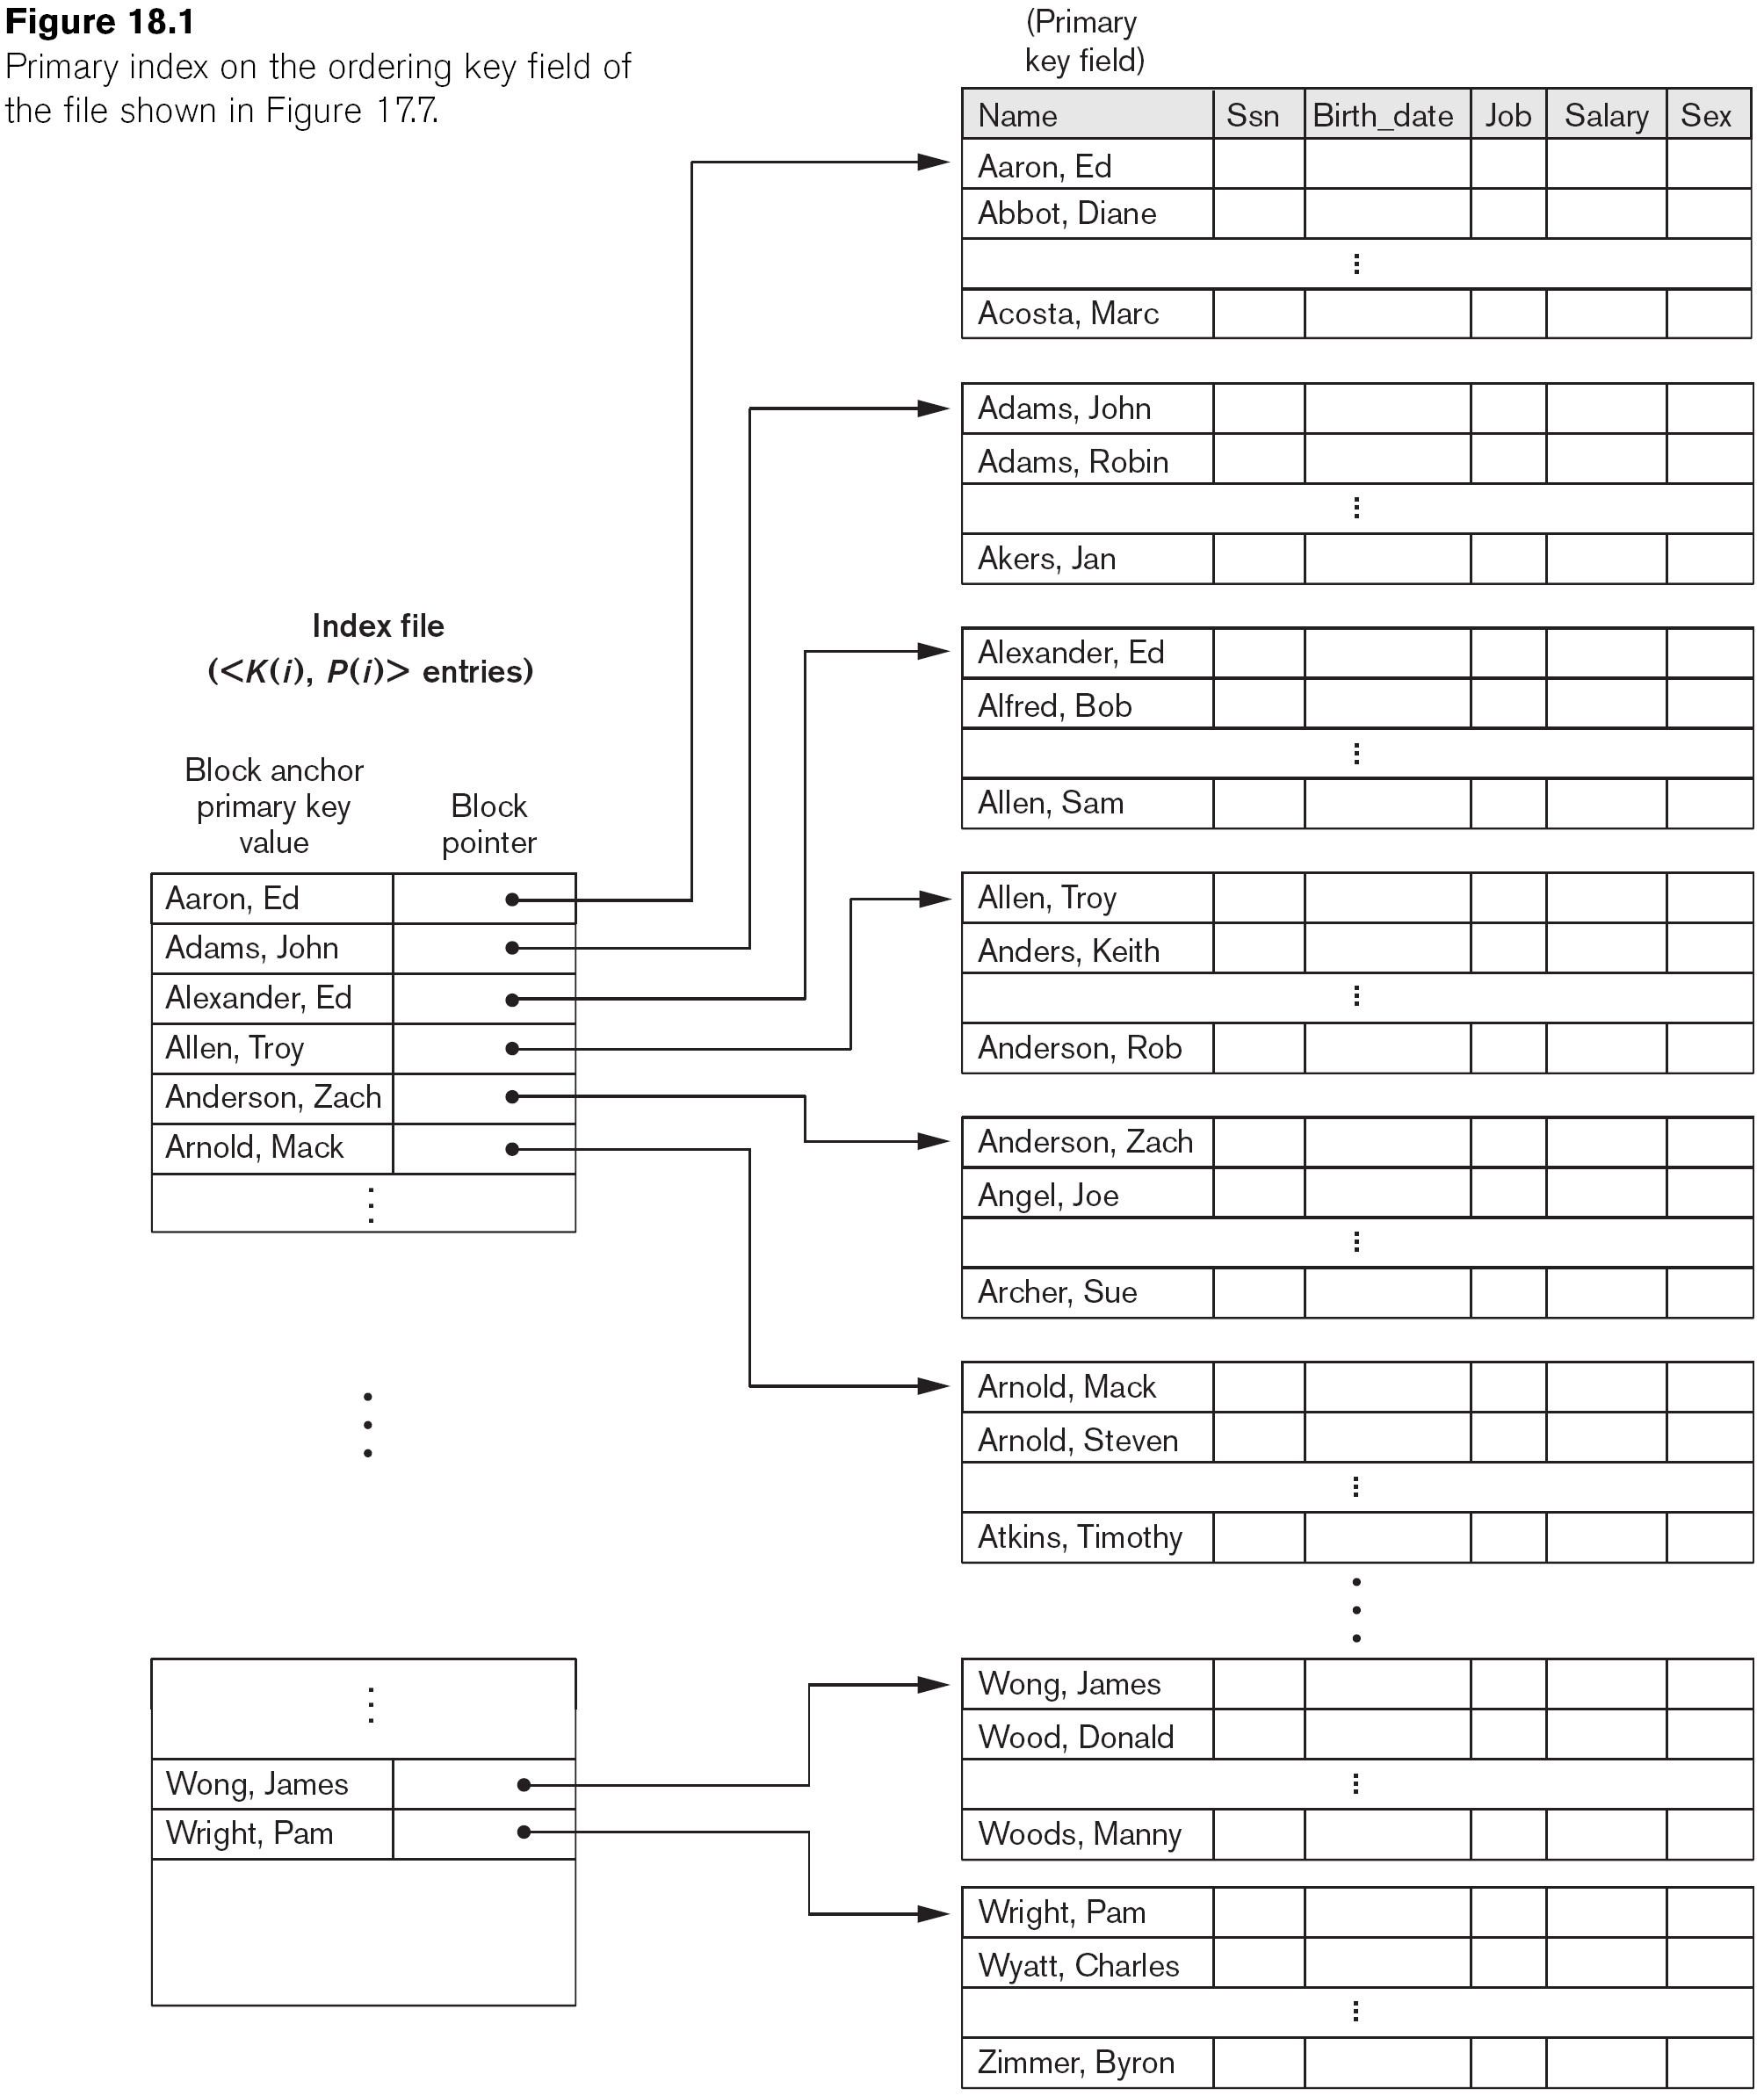
Primary Index on the Ordering Key Field

Slide 11
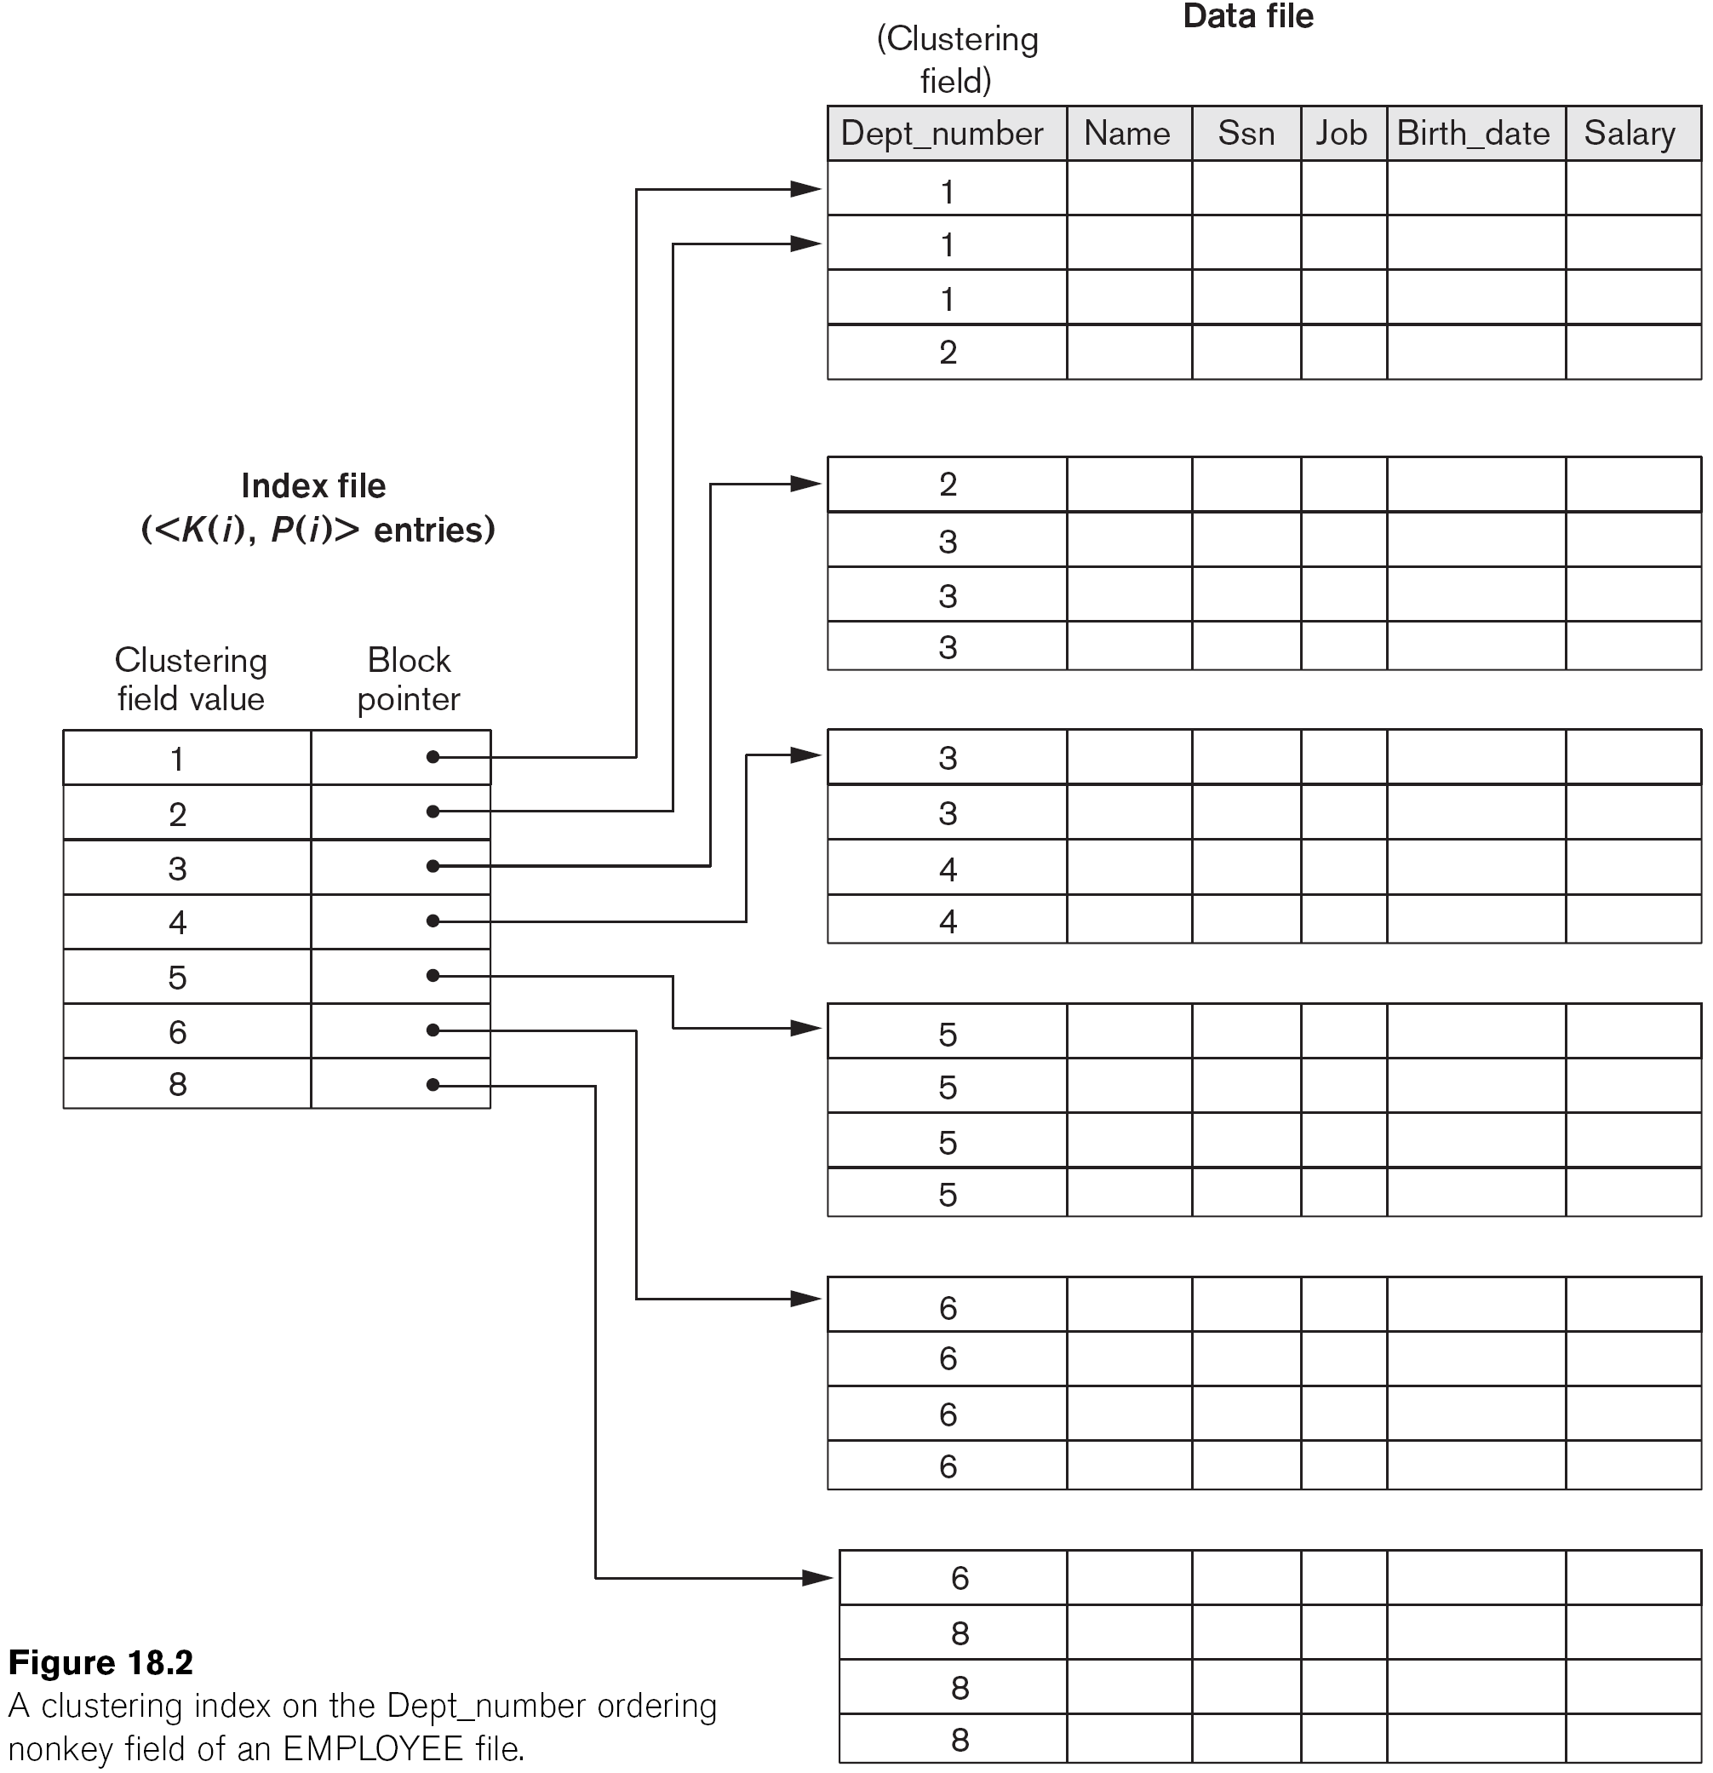
A Clustering on non-key Index Example

Slide 12
Clustered / Non clustered index
Clustered index
data rows of the underlying table are sorted and stored in order dictated by the index
can only be one clustered index for a table
Non-clustered index
data rows of the underlying table are not stored in order dictated by the index
There might be several non-clustered indexes per table
Records
Records
Notes:
Clustered indices tend to be more expensive to Maintain
Unclustered index = the actual data are not stored in the order dictated by the index
Sometimes referred to as secondary index
Secondary indexes must be dense
The pointers of a secondary indexes may point to many blocks of the data file
Making secondary indexes less efficient than primary indexes
Heap (data) files are not ordered so require secondary indexes
A primary index = an index where the search key includes the primary key
A clustered index on attribute X co-locates records whose X values are near to one another.

Slide 13
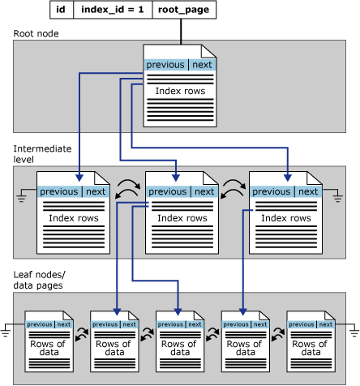
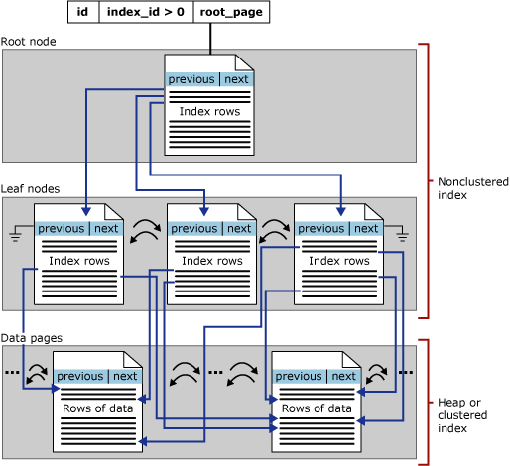
Physical Index B-Tree Layout
Clustered Index
Non-Clustered

Slide 14
Dense / Sparse Index
Sparse index
Pointers are associated to Blocks
index contain <KeyValue : pointer to block>. One index entry for each data block
Only a clustering index can be sparse
The index is searched for the largest key less than or equal to the desired value
The pointer is then followed to a block of the data file
Dense index
index contain < KeyValue: pointer to record>. Pointers are associated to records
Non clustered indexes are dense: one entry for each distinct value of the search key
B₁
B₂
B_{i}
record
record
record
Notes:
A dense index contain <search key : pointer to record> pairs
Pointers are addresses to the records with the search key
The blocks of the index are in the same order as the file
Searching an index is faster than searching the file
The index is smaller than the file
The index is sorted so binary search can be used
The index may be small enough to fit in main memory
If so records can be found with one disk I/O
Sparse:
A sparse index usually contains one data entry for each block of records in a data file
It is only possible to use a sparse index if the data file is sorted by the search key of the index
Sparse indexes are usually smaller than dense indexes
Sparse indexes are searched in much the same way as dense indexes
Except that the index is searched for the largest key less than or equal to the target value
The pointer is then followed to a block of the data file

Slide 15
Dense vs. Sparse Indexes
Ashby, 25, 3000
Basu, 33, 4003
22
Bristow, 30, 2007
25
Ashby
30
Cass
Cass, 50, 5004
33
Smith
Daniels, 22, 6003
Jones, 40, 6003
40
44
Smith, 44, 3000
44
Tracy, 44, 5004
50
Sparse Index
Dense Index
on
Data File
on
Name
Age
Notes:
Every sparse index is clustered!

Slide 16
Covering Index
Select name from employee where department = “marketing”
Good covering index would be on (department, name) -composite search keys-
Covering index performs better than clustering index when first attributes of index are in the where clause and last attributes in the select.
Index on (name, department) less useful.
Index on department alone moderately useful
Notes:
An index’s search key can contain several fields
Such search keys are referred to as composite search keys or concatenated keys
e.g. {fName, lName}
For searches on equality the values for each field in the search key must match the values in record
e.g. 'Joe Smith' does not match 'Joe Jones' or 'Fred Smith'
For range queries, ranges may be specified for any fields in the search key.
If no values are specified for a field it implies that any value is acceptable for that field

Slide 17
Tree Based Indexes
Notes:
In a B-tree, pointers to data records exist at all levels of the tree
In a B+-tree, all pointers to data records exists at the leaf-level nodes
A B+-tree can have less levels (or higher capacity of search values) than the corresponding B-tree

Slide 18
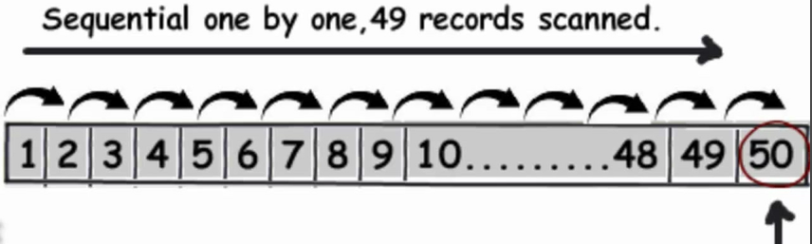
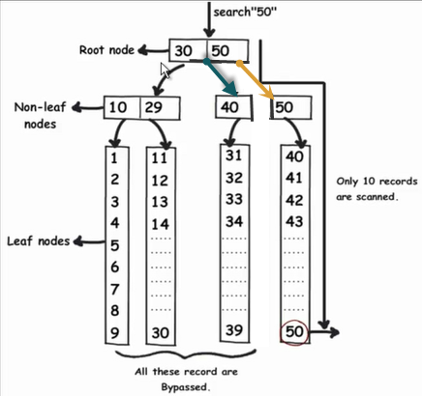
Full Table Scan vs. Index Access
Vs. Index Access

Slide 19
Single Level Indexes
``Find all students with gpa > 3.0’’
If data is in sorted file, do binary search to find first such student, then scan to find others.
Cost of binary search can be quite high.
Simple idea: Create an `index’ file.
k1
k2
kN
Index File
Page 1
Page 2
Page 3
Page N
Data File
Can do binary search on (smaller) index file!
Notes:
3

Slide 20
Multiple Level Indexes
An index on a large data file can cover many blocks
Even using binary search multiple disk I/Os may be needed to find a record
An alternative is to build a multiple level index
Notes:
The first level of the index may be dense or sparse
Subsequent levels of the index are sparse indexes on the preceding level of the index

Slide 21
Multiple Level Index
multiple level index
10
20
30
41
53
60
77
91
10
20
30
41
53
60
77
91
10
53
...
Data file

Slide 22
Tree Index Introduction
Multiple level indexes can be very useful in speeding up queries
There is a general data structure that is commonly used in commercial DBMSs known as B trees
B trees have two desirable properties
They keep as many levels as are required for the file being indexed
Space on the tree blocks is managed so that each block is at least ½ full
B-Tree supports equality and range searches + tree grows and shrinks dynamically
Notes:
Supports equality and range searches, multiple attribute keys and partial key searches

Slide 23
B Tree Structure
B trees are balanced structures
All paths from the root to a leaf have the same length
Most B trees have three levels. But any number of levels is possible
B trees are similar to binary search trees
Except that B tree nodes contain more than two children => they have greater fan-out
B tree node size is chosen to be the same as a disk block
Notes:
B trees can be used to build many different indexes
The B tree could be a sparse index on a sorted data file, or
A dense index on a data file

Slide 24
B Tree Node Structure
The number of data entries in a node is determined by the size of the search key
Up to n search key values and n + 1 pointers
The value n is chosen to be as large as possible and still allow n search keys and n + 1 pointers to fit on a block
Example
If block size is 4,096, and the keys are 4 byte integers and pointers are 8 byte addresses
Find the largest value n such that 4n + 8(n + 1) ≤ 4,096
n = 340

Slide 25
Leaf Nodes
Search keys in leaf nodes point to the data file buckets (or records)
Leaf nodes contain sorted linked list of index entries
A leaf node must have at least ⎣(n + 1)/2⎦ pointers
The right most pointer points to the next leaf
next leaf in the tree
 | 12 |  | 24 |  | 29
record with key 12
record with key 24
record with key 29
Notes:
The leaf nodes contain the keys in order
The left most n pointers point to records in the data file
Minimum Occupancy = (n + 1)/2 pointers = half-full

Slide 26
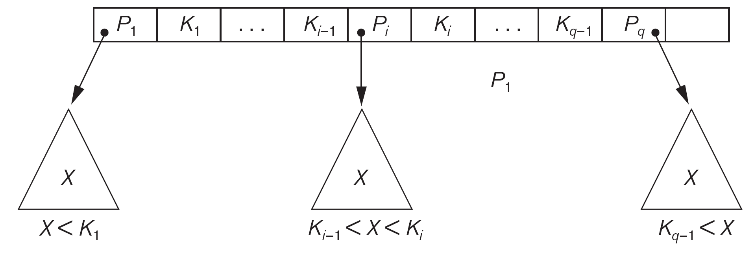
Interior Nodes
In interior nodes, pointers point to next level nodes
Label the search keys K₁ to K_{n}, and pointers p₀ to p_{n}
Pointer p₀ points to nodes whose search key values are less than K₁
Other pointers, p_{i}, point to nodes with search keys greater than or equal to K_{i} and less than K_{i+1}
An interior node must use at least ⎡(n + 1)/2⎤ pointers
 | 12 |  | 24 |  | 29
12 ≤ K < 24
24 ≤ K < 29
K < 12
K ≥ 29
Notes:
Insertion and Deletion in B+Tree
•Structure of tree changes to handle row insertion and deletion –no overflow chains
•Tree remains balanced: all paths from root to index entries have same length

Slide 27
Meaning of Internal Node
84
91
key < 84
84 ≤ key < 91
Key >= 91

Slide 28
Meaning of Leaf Nodes
63
76
Next leaf
pointer to record 63
pointer to record 76

Slide 29
B-Trees Space related constraints
Use at least Root: 2 pointers Internal: ⎡(n+1)/2⎤ pointers Leaf: ⎣(n+1)/2⎦ pointers to data

Slide 30
Leaf Nodes
m ≥
(n+1)
⎣
⎦
2
unused
n key slots
k
k
k
…
…
k
1
2
3
m
(n+1) pointer slots
…
…
…
next leaf
record of k
1
record of k
record of k
2
m

Slide 31
Internal Nodes
⎡
(n+1)
⎤
(m+1) ≥
2
unused
n key slots
k
k
k
k
1
2
3
m
(n+1) pointer slots
key < k
1
k ≤ key < k
k ≤ key
1
2
m

Slide 32
Root Node
(m+1) ≥
2
unused
n key slots
k
k
k
k
1
2
3
m
(n+1) pointer slots
key < k
1
k ≤ key < k
k ≤ key
1
2
m

Slide 33
Example B Tree
17
in this example n = 3
Each node has at least ⎡(n+1)/2⎤ = 2 pointers.
10
27 |  | 87
2 |  | 5
10 |  | 13 |  | 15
17 |  | 22
27 |  | 35
87 |  | 91
Notes:
We will assume for now that there are no duplicate values for search keys
That is the search key is a candidate key for the relation
The meaning of interior nodes changes slightly if there are duplicate search key values

Slide 34
Searching a B Tree
The B tree search algorithm
To search for a value K start at the root and end at a leaf
If the node is a leaf and the i^{th} key has the value K then follow the i^{th} pointer to the record
If the node is an interior node follow the appropriate pointer to the next (interior or leaf) node
Searching a B tree index requires a number of disk I/O equal to the height of the tree
Plus one I / O to retrieve the record
However the root of the tree may be in main memory
Notes:
is similar to a BST

Slide 35
B Tree Searches
which nodes are visited in a search for 22?
17
which nodes are visited in a search for 16?
10
27 |  | 87
2 |  | 5
10 |  | 13 |  | 15
17 |  | 22
27 |  | 35
87 |  | 91

Slide 36
Range Queries
B trees are useful for processing range queries
A range query typically has a WHERE clause that specifies a range of values
Assume query specifies values from x to y
Search the tree for the leaf that should contain value x
Follow the leaf pointers until a key greater than y is found
The tree can also be used to satisfy queries that have no lower bound or no upper bound

Slide 37
Inserting a Data Entry into a B+ Tree
Find correct leaf L.
Put data entry onto L.
If L has enough space, done!
Else, must split L (into L and a new node L2)
Redistribute entries evenly, copy up middle key.
Insert index entry pointing to L2 into parent of L.
This can happen recursively
To split an interior node, redistribute entries evenly, but push up middle key.
Splits “grow” tree => tree gets wider.
Splits could propagate to root => increasing tree height
Notes:
6
root split increases height.
Tree growth: gets wider or one level taller at top.
Insert the record in the in the data file
Retaining the rid and the search key value, K
Insert the entry in the appropriate place in a leaf
Use the search algorithm to find the leaf node
Insert a data entry, if it fits the process is complete
If the target leaf node is full then split it
The first ⎡(n + 1) / 2⎤ entries stay in the original node
Create a new node with the remaining ⎣(n + 1) / 2⎦ entries to the right of the original node
Insert an entry with the first search key value from the new leaf node in the parent node to point to the new node
Adding an entry to an interior node may cause it to split
The first ⎡(n + 2) / 2⎤ pointers stay in the original node
Create a new node with the remaining ⎣(n + 2) / 2⎦ pointers to the right of the original node
Leave the first ⎡n / 2⎤ keys in the original node and move the last ⎡n / 2⎤ keys to the new node
After inserting a new entry there should be n + 1 keys (and n + 2 pointers)
The remaining key will be a median value between the values in the original and new node
This left over key is inserted into the parent of the node along with a pointer to the new node
Moving a value to a higher, interior level of the tree, again cause a split
The same process is repeated until no further splits are required, or until a new root node has been created
If a new root is created it will initially have just one key and two children
So will be less than half full
This is permitted for the root (only)

Slide 38
B Trees Insertion Example
insert 2, 21 and 11
2 |  | 11 |  | 21
the values are maintained in order in the index pages
data file

Slide 39
B Trees Insertion Example
insert 8
11
create new root with the first value of the new leaf node
2 |  | 11 |  | 21
2 |  | 8
11 |  | 21
create a new node with the last ½ of the values
chain the new node to the original node

Slide 40
B Trees Insertion Example
insert 64, then 5
insert 23 ...
11
2 |  | 8
2 |  | 5 |  | 8
11 |  | 21
11 |  | 21 |  | 64
both leaf nodes are now full ...

Slide 41
B Trees Insertion Example
... inserting 23 ...
11
11 |  | 23
2 |  | 5 |  | 8
11 |  | 21 |  | 64
11 |  | 21
23 |  | 64

Slide 42
B Trees Insertion Example
insert 6
11 |  | 23
6 |  | 11 |  | 23
2 |  | 5 |  | 8
2 |  | 5
6 |  | 8
11 |  | 21
23 |  | 64

Slide 43
B Trees Insertion Example
insert 6
6 |  | 11 |  | 23
2 |  | 5 |  | 8
2 |  | 5
6 |  | 8
11 |  | 21
23 |  | 64

Slide 44
B Trees Insertion Example
insert 19 and 9
6 |  | 11 |  | 23
2 |  | 5 |  | 8
2 |  | 5
6 |  | 8
6 |  | 8 |  | 9
11 |  | 21
11 |  | 19 |  | 21
23 |  | 64

Slide 45
B Trees Insertion Example
the same tree ...
6 |  | 11 |  | 23
2 |  | 5
6 |  | 8 |  | 9
11 |  | 19 |  | 21
23 |  | 64

Slide 46
B Trees Insertion Example
insert 7
which will require that it splits
and now insert 8 in the parent
6 |  | 11 |  | 23
2 |  | 5
6 |  | 8 |  | 9
6 |  | 7
8 |  | 9
11 |  | 19 |  | 21
23 |  | 64

Slide 47
B Trees Insertion Example
insert 7 – inserting 8 and a pointer in the root node
and make the middle value the new root
11
keep ½ the pointers and the first ⎡n/2⎤ values
6 |  | 11 |  | 23
move ½ the pointers and the last ⎣n/2⎦ values
6 |  | 8
23
2 |  | 5
6 |  | 7
8 |  | 9
11 |  | 19 |  | 21
23 |  | 64

Slide 48
B Trees Insertion Example
tree after inserting 7
11
6 |  | 8
23
2 |  | 5
6 |  | 7
8 |  | 9
11 |  | 19 |  | 21
23 |  | 64
Notes:
insert values 31, 39, 45, 51, 60, 93

Slide 49
B Trees Insertion Example
insert values 31, 39, 45, 51, 60, 93
11
6 |  | 8
23 |  | 45 |  | 60
2 |  | 5
6 |  | 7
8 |  | 9
11 |  | 19 |  | 21
23 |  | 31 |  | 39
45 |  | 51
60 |  | 64 |  | 93

Slide 50
B Trees Insertion Example
and insert 77
11
6 |  | 8
23 |  | 45 |  | 60
77 |  | 93
2 |  | 5
6 |  | 7
8 |  | 9
11 |  | 19 |  | 21
23 |  | 31 |  | 39
45 |  | 51
60 |  | 64 |  | 93
60 |  | 64

Slide 51
B Trees Insertion Example
... and insert 77 ...
11
now insert 60 in the root
6 |  | 8
23 |  | 45 |  | 60
23 |  | 45
77
77 |  | 93
2 |  | 5
6 |  | 7
8 |  | 9
11 |  | 19 |  | 21
23 |  | 31 |  | 39
45 |  | 51
60 |  | 64

Slide 52
B Trees Insertion Example
... and insert 77 ...
11
11 |  | 60
now insert 60 in the root
6 |  | 8
23 |  | 45
77
77 |  | 93
2 |  | 5
6 |  | 7
8 |  | 9
11 |  | 19 |  | 21
23 |  | 31 |  | 39
45 |  | 51
60 |  | 64

Slide 53
Deleting a Data Entry from a B+ Tree
Start at root, find leaf L where entry belongs.
Remove the entry.
If L is at least half-full, done!
If L has less (n+1)/2 entries,
Try to re-distribute, borrowing from sibling (adjacent node with same parent as L).
If re-distribution fails, merge L and sibling.
If merge occurred, must delete entry (pointing to L or sibling) from parent of L.
Merge could propagate to root, decreasing height.
Notes:
14
Find the entry in the leaf node and delete it
This may result in there being too few entries in the node
If so select an adjacent sibling of the node and
Redistribute values between the two nodes
So that both nodes have enough entries
If this is not possible
Coalesce the two nodes
Delete the appropriate value and pointer in the parent node
When redistribution is not possible, two nodes can be combined (or coalesced if you prefer)
Keep track of the value in the parent between the pointers to the two nodes to be combined
Insert all of the values (and pointers) from one node into the other
Re-connect links between leaves (if the nodes are leaves)
Make a recursive call to the deletion process, deleting the identified value in the parent node
This, in turn, may require non-leaf nodes to be coalesced
A value and pointer are removed from an adjacent sibling and inserted in the node with insufficient entries
The sibling can be the left or the right sibling, although it makes a slight difference to the process
The chosen node must be a sibling to ensure that only a single parent node is affected
After redistribution, one of the two nodes will have a different first search key value
The corresponding value in the parent node must be changed to this value
If the node's sibling(s) have insufficient entries redistribution may not be possible
The deletion algorithm requires a choice to be made between siblings
Such a choice has to be implemented in the algorithm
Coalescing nodes requires more work
It may result in making changes up the tree, but
The tree height may be reduced
Redistributing nodes requires less work, but does not impact the height of the tree
When redistribution is not possible, two nodes can be combined (or coalesced if you prefer)
Keep track of the value in the parent between the pointers to the two nodes to be combined
Insert all of the values (and pointers) from one node into the other
Re-connect links between leaves (if the nodes are leaves)
Make a recursive call to the deletion process, deleting the identified value in the parent node
This, in turn, may require non-leaf nodes to be coalesced

Slide 54
B Trees Deletion Example
delete 19
11
11 |  | 60
6 |  | 8
23 |  | 45
77
77 |  | 93
2 |  | 5
6 |  | 7
8 |  | 9
11 |  | 19 |  | 21
11 |  | 21
23 |  | 31 |  | 39
45 |  | 51
60 |  | 64
use search to find the value
delete the record in the data file first

Slide 55
B Trees Deletion Example
11
11 |  | 60
delete 45
6 |  | 8
23 |  | 45
77
77 |  | 93
2 |  | 5
6 |  | 7
8 |  | 9
11 |  | 21
23 |  | 31 |  | 39
45 |  | 51
51
60 |  | 64
use search to find the value
delete the record in the data file first
the node is less than half full: ⎣(n + 1)/2⎦ pointers to records

Slide 56
B Trees Deletion Example
delete 45
11
11 |  | 60
change the value in the parent node
6 |  | 8
23 |  | 45
23 |  | 39
77
77 |  | 93
2 |  | 5
6 |  | 7
8 |  | 9
11 |  | 21
23 |  | 31 |  | 39
23 |  | 31
51
39 |  | 51
60 |  | 64
take a value from the left sibling node

Slide 57
B Trees Deletion Example
delete 9
11
11 |  | 60
6 |  | 8
23 |  | 39
77
77 |  | 93
2 |  | 5
6 |  | 7
8 |  | 9
11 |  | 21
23 |  | 31
39 |  | 51
60 |  | 64
leaf nodes must use ⎣(n + 1)/2⎦ = 2 pointers
Cannot get keys from a sibling
so must merge the node with its L sibling

Slide 58
B Trees Deletion Example
delete 9
11
11 |  | 60
now delete entry and pointer from parent
6 |  | 8
23 |  | 39
77
77 |  | 93
2 |  | 5
6 |  | 7
6 |  | 7 |  | 8
8 |  | 9
11 |  | 21
23 |  | 31
39 |  | 51
60 |  | 64
leaf nodes must use ⎣(n + 1)/2⎦ = 2 pointers
Cannot get keys from a sibling
so must merge the node with its L sibling

Slide 59
B+ Trees Deletion Example
delete 9
11
11 |  | 60
note that these nodes have enough (2) pointers
now delete entry and pointer from parent
6 |  | 8
6
23 |  | 39
77
77 |  | 93
2 |  | 5
6 |  | 7
6 |  | 7 |  | 8
11 |  | 21
23 |  | 31
39 |  | 51
60 |  | 64

Slide 60
B Trees Deletion Example
delete 6
11
11 |  | 60
the parent entry doesn't need to change
6 |  | 8
6
23 |  | 39
77
77 |  | 93
2 |  | 5
6 |  | 7
6 |  | 7 |  | 8
7 |  | 8
11 |  | 21
23 |  | 31
39 |  | 51
60 |  | 64

Slide 61
B Trees Deletion Example
delete 8
11
11 |  | 60
now delete entry and pointer from parent
6 |  | 8
6
23 |  | 39
77
77 |  | 93
2 |  | 5
2 |  | 5 |  | 7
7 |  | 8
11 |  | 21
23 |  | 31
39 |  | 51
60 |  | 64

Slide 62
B Trees Deletion Example
… delete 8 …
which value?
11
11 |  | 60
so take a pointer from sibling
just 1 pointer
now delete entry and pointer from parent
6
23 |  | 39
77
77 |  | 93
2 |  | 5 |  | 7
11 |  | 21
23 |  | 31
39 |  | 51
60 |  | 64

Slide 63
B Trees Deletion Example
… delete 8 …
which value?
11
11 |  | 60
23 |  | 60
11
23 |  | 39
39
77
77 |  | 93
2 |  | 5 |  | 7
11 |  | 21
23 |  | 31
39 |  | 51
60 |  | 64

Slide 64
B Trees Deletion Example
… delete 8 finished
23 |  | 60
11
39
77
2 |  | 5 |  | 7
11 |  | 21
23 |  | 31
39 |  | 51
60 |  | 64
77 |  | 93

Slide 65
B Tree Height
Assume a block size of 4,096 and the keys are 4 byte integers and pointers are 8 byte addresses
Each tree node can contain 340 key values and pointers
If each node is 2/3 full that is 255 pointers
How many records can be accessed by such a tree with 3 levels?
255³ = 16,600,000 records

Slide 66
B Tree Efficiency
Splitting and merging of index blocks are not frequent
Typically the value of n will be much greater than 3!
Most splits or merges are limited to two leaves and one parent
The number of disk I/Os is based on the tree height
It is a reasonable assumption that the majority of B trees have height of 3
And one level is the root (i.e. one block) which can reside in main memory
Some B tree implementations do not delete interior nodes
if a leaf has too few keys and pointers it is allowed to remain unchanged
It is assumed that most DB files tend to grow not shrink
Notes:
Some B tree implementations don't fix interior nodes for deletions
If a leaf has too few keys and pointers it is allowed to remain unchanged
It is assumed that most DB files tend to grow not shrink
It also allows efficient access to records replaced by tombstones in the data file

Slide 67
Key Compression
The height of a tree is determined by the fan-out
The number of children of each node
The fan-out is determined by the number of search key values and pointers that can fit in one page
A smaller search key leads to a greater fan-out and a tree with fewer levels
It may be possible to compress search keys
For example, a search key on last name can be truncated to the extent that it is still sufficient to guide the search

Slide 68
Hash Indexes
#
Notes:
We always start with 2 buckets for both Linear Hashing and Extensible Hashing.
The number of buckets is 2 power Global Depth

Slide 69
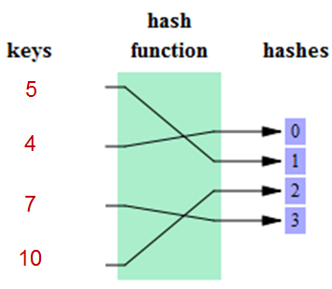
Hash Tables in Main Memory
In a hash table a hash function maps search key values to array elements
The array can either contain the data objects, or
Linked lists containing data objects (often called buckets)
Hash functions generate a value between 0 and B-1
Where B is the number of buckets
A record with search key K is stored in bucket h(K)
A typical hash functions is a bit representation of (the Search Key Value modulus the Number of Buckets)
Hash indexes do not support range lookup
Notes:
A bucket is a unit of storage containing one or more records (a bucket is typically a disk block).

Slide 70

Hash Index
A hash index stores key-value pairs based on a hash function => an array of pointers to buckets
The hash function often is K mod B
Where K is the key value and B is the number of buckets
Collision is resolved by placing new values in an overflow bucket
Hashed key
values
key
Hash function
0
6
6
1
7 10 13
16 19 22
25
The length of these overflow chains impacts performance
n
n=3
Notes:
Buckets should consist of single blocks
Full buckets can be chained to overflow blocks
The bucket locations need to be recorded
e.g. an array of pointers to buckets, or
The first block of each bucket is stored in consecutive disk locations
The number of buckets should be greater than
Number of data entries ÷ entries per page
A hash function would compute the remainder of K/B
Where K is the key value and B is the number of buckets
Buckets should consist of single blocks
The number of buckets should be greater than
Number of data entries ÷ entries per page
The first block of each bucket is stored in consecutive disk locations
Pseudo-randomizing function called a hash function.
Overflow buckets + Offline reorganization
Good for point queries
The bucket locations need to be recorded
e.g. an array of pointers to buckets, or

Slide 71
Static Hashing vs. Dynamic Hashing
In static hashing the number of buckets is fixed
If the file grows most buckets will have overflow chains, reducing efficiency
=> There should be enough buckets so that there are few overflow blocks
Two versions of dynamic hashing that allow dynamic File Expansion
Extensible hashing
Linear hashing
Notes:
Compute h(K) when a new record is to be inserted
Insert the record in the bucket (or its overflow blocks)
If necessary add an overflow block
Deletion is similar to insertion
Use the hash function to find bucket h(K)
Delete any records with search key K
Consider combining blocks if possible
most fit on one block i.e
Both systems use the concept of a family of hash functions
As the size of the index grows larger, more disk pages are required to store the data entries
Rather than creating overflow pages, additional buckets are created, and
The range of the hash function is increased

Slide 72
Extensible Hashing Structure
In extendible hashing there is a directory to buckets
The directory is an array of pointers to buckets
As the array only contains pointers it is relatively small, so it can usually fit in memory
The directory size is doubled when overflow occurs
New buckets are only created as necessary
The hash function computes a sequence of bits
The directory (and the associated buckets) uses the last i bits of the hash value
The directory will have 2^{i} entries
When the directory grows, i+1 bits of the hash value are used
Notes:
The directory consists of an array of pointers to buckets
As the array only contains pointers it is relatively small, so it can usually fit in memory
The array index is calculated with the hash function
And is determined by the relevant bits of the hash value
The array size is determined by how many bits of the hash function are being used
The directory size is doubled when overflow occurs
If the directory needs to increase in size, it doubles
The array's size is always a power of 2.
Even though the directory may become large, new buckets are only created when overflow occurs
Consider a hash function that returns some bit value
e.g. 0100 1101 0110 0101
The bucket can be derived by calculating the bit value modulus n (the number of buckets)
Note that if n is a power of 2 the bucket can be determined by looking at the last k bits (where n = 2^{k})
e.g. if n = 8 the bit value shown above maps to bucket 5
The range of a hash function can be doubled by increasing the number of relevant bits by one
Consider a hash function that returns a bit value
e.g. 0100 1101 0111 0101
The bucket can be derived by calculating the bit value modulus B (the number of buckets)
Note that if B is a power of 2 the bucket can be determined by looking at the last k bits (where B = 2^{k})
e.g. if B = 8 the bit value shown above maps to bucket 5
The range of the hash function can be doubled by increasing the number of bits by one

Slide 73
Extensible Hashing Example
Directory is array of size 4.
Assume a bucket capacity of 4
What info this hash data structure maintains?
Global Depth: # of bits needed to tell which bucket an entry belongs to
Local Depth: # of bits used to determine if an entry belongs to a specific bucket
LOCAL DEPTH
2
4
12
32
16
Bucket A
GLOBAL DEPTH
2
2
00
1
5
21
13
Bucket B
01
10
2
11
10
Bucket C
DIRECTORY
2
15
7
19
Bucket D
DATA PAGES
Notes:
6
Can global depth < local depth?

Slide 74
Insert 20 (10100): Double Directory
LOCAL DEPTH
2
4
12
32
16
Bucket A
GLOBAL DEPTH
3
LOCAL DEPTH
2
2
GLOBAL DEPTH
32
16
Bucket A
00
1
5
21
13
Bucket B
01
3
2
10
2
000
1
5
21
13
Bucket B
11
10
Bucket C
001
010
2
2
011
10
Bucket C
DIRECTORY
Bucket D
15
7
19
100
101
2
Split the bucket when local depth = global depth
- if yes, double the directory + rehash the entries and distribute into two buckets
- if no, rehash the entries and distribute them into two buckets.
- increment the local depth.
15
110
7
19
Bucket D
111
3
DIRECTORY
4
12
20
Bucket A2
(`split image'
of Bucket A)
Notes:
7
Know the difference between double directory & split bucket.
double directory:
Increment global depth
Rehash bucket A
Increment local depth, why track local depth?

Slide 75
Insert 9 (1001): only Split Bucket
LOCAL DEPTH
3
LOCAL DEPTH
3
GLOBAL DEPTH
32
16
Bucket A
GLOBAL DEPTH
32
16
Bucket A
3
2
3
3
000
1
5
21
13
Bucket B
000
1
9
Bucket B
001
001
010
2
010
2
011
10
Bucket C
011
10
Bucket C
100
100
101
2
101
2
110
15
7
19
Bucket D
110
15
7
19
Bucket D
111
111
3
DIRECTORY
3
DIRECTORY
4
12
20
Bucket A2
4
12
20
Bucket A2
3
Only split bucket:
Rehash bucket B
Increment local depth
21
13
Bucket B2
5
(split image of Bucket B)
Notes:
7
Split the bucket
-> check local depth = global depth
-> if yes, double the directory -> rehash the entries and distribute into two buckets
-> if no, rehash the entries and distribute them into two buckets.
-> increment the local depth.

Slide 76
Extensible Hashing - Points to Note
What is the global depth of directory?
Max # of bits needed to tell which bucket an entry belongs to.
What is the local depth of a bucket?
# of bits used to determine if an entry belongs to a specific bucket
When does bucket split cause directory doubling?
Bucket is full & local depth = global depth.
How to efficiently double the directory?
Directory is doubled by copying it over and `fixing’ pointers to the splited bucket
Notes:
8
Note that you can do this only by using the least significant bits (right-most bits) in the directory.
Why use least significant bits in directory? => Allows for doubling via copying!
Before insert, bucket is full & local depth = global depth.

Slide 77
Linear Hashing (LH)
Another dynamic hashing scheme, as an alternative to Extendible Hashing.
What are problems in static/extendible hashing?
Static hashing can cause long overflow chains
Extendible hashing: data skew causing large directory
Data skew = Multiple entries with same hash value
If bucket already full of same hash value, will keep doubling forever!
Is it possible to come up with a more balanced solution?
Shorter overflow chains than static hashing
No need for directory
=> Linear Hashing is the answer
Notes:
10
Biggest problem:
Multiple entries with same hash value cause problems!
If bucket already full of same hash value, will keep doubling forever! So must use overflow buckets if dups.

Slide 78
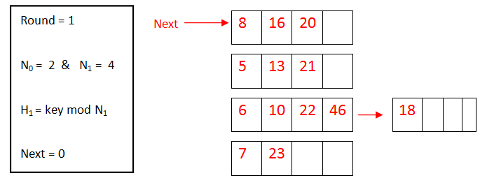
Linear Hashing Algorithm
Initial Stage.
The initial level distributes entries into N₀ buckets.
The hash function to perform is noted h₀
Idea: Use a family of hash functions h₀, h₁, h₂, ...
h_{i}(key) = key mod(2^{i}N_{o}); N₀ = initial # buckets
h_{i+1} doubles the range of h_{i} (similar to directory doubling)
Example
Notes:
LH key parameters:
Round = 0
N_{round} = # buckets
Next = bucket the Next Pointer is pointing to
h is some hash function (range is not 0 to N-1)
If N = 2^{d0}, for some d0, h_{i} consists of applying h and looking at the last di bits, where di = d0 + i.
Linear hashing is another dynamic hashing system
The number of buckets (n) is selected to maintain an average occupancy in buckets e.g. 80%
Buckets are not always split when full
So overflow blocks are allowed
The average number of overflow blocks per bucket is less than 1
Linear hashing does not use a directory
Like extensible hashing only the right most i bits of h(K) are used to determine a bucket
The number of bits used to number the entries in the bucket array is ⎡log₂n⎤
Linear hashing does not use a directory
The hash function determines which bucket a record is mapped to
The primary blocks of the buckets are stored sequentially
So that bucket m can be found by adding m to the address of the first bucket
Like extensible hashing only the right most i bits of h(K) are used to determine a bucket

Slide 79
Linear Hashing Verbal Algorithm
Splitting buckets
If a bucket overflows its primary page is chained to an overflow page + some bucket is split
The first bucket to be split is the first bucket (not necessarily the bucket that overflows)
The next bucket to be split is the second bucket in the file … and so on until the N^{th} has been split
When buckets are split their entries (including those in overflow pages) are distributed using h₁
To access split buckets the next level hash function (h₁) is applied
H₁ maps entries to 2N_{o} buckets
Alternatively, splitting can be triggered when a fill factor (average occupancy in buckets e.g. 80%) is exceeded
Notes:
(same as in static hashing)
Basic Idea:
Pages are split when overflows occur – but not necessarily the page with the overflow.
Splitting occurs in turn, in a round robin fashion.
one by one from the first bucket to the last bucket.
Use a family of hash functions h₀, h₁, h₂, ...
Each function’s range is twice that of its predecessor.
When all the pages at one level (the current hash function) have been split, a new level is applied.
Splitting occurs gradually
Primary pages are allocated in order & consecutively.
At any time i bits of the hash value are used to map records to n buckets
Values for the i bits range from 0 to 2^{i}-1
The value for n may be less than 2^{i}-1
Computing h(K) on a search key value K results in a value m for the last i bits of h(K)
If m < n place the record in bucket m
If n ≤ m < 2^{i} then place m in bucket m - 2^{i-1}
i.e. change the left most bit of m to 0

Slide 80
Linear Hashing Example
Let’s start with N = 4 Buckets
Start at “round” 0, “next” 0
Each time any bucket fills, split “next” bucket
If (0 ≤ h_{round}(key) < Next) then Use h_{round+1}(key) instead
Start
Add 9
Next
4
12
32
16
32
16
Add 20
1
5
21
13
Next
1
5
21
13
9
32
16
10
10
Next
1
5
21
13
9
N_{round}
15
N_{round}
15
10
4
12
N_{round}
15
4
12
20
Notes:
, have 2^{round} buckets

Slide 81
Linear Hashing Example (cont)
Overflow chains do exist, but eventually get split
Instead of doubling, new buckets added one-at-a-time
Add 6
Add 17
32
16
32
16
Next
1
5
21
13
9
1
13
10
6
Next
10
6
N_{round}
15
N_{round}
15
4
12
20
4
12
20
5
21
9

Slide 82
Linear Hashing (Contd.)
Directory avoided in LH by using overflow buckets, and choosing bucket to split in round-robin.
Splitting proceeds in `rounds’. Round ends when all N_{R} initial (for round R) buckets are split.
Search: To find bucket for data entry r, find h_{round}(r):
If h_{round}(r) in range `Next to N_{R}’ , r belongs here.
Else, must apply h_{round+1}(r) to find out.
Notes:
11
r could be h_{round}(r) or h_{round}(r) + N_{R};
Current round number also called Level.
Buckets 0 to Next-1 have been split; Next to N_{R} yet to be split.

Slide 83
Overview of LH File
In the middle of a round.
Buckets split in this round:
Bucket to be split
If
h
(
search key value
round
)
Next
is in this range, must use
h
(
search key value
round+1
)
Buckets that existed at the
to decide if entry is in
beginning of this round:
`split image' bucket.
this is the range of
h
round
buckets created (through
splitting of other buckets) in
this round
Notes:
11

Slide 84
Linear Hashing Example
Initially, we have N₀ = 4 buckets
Assume three entries fit on a bucket
h₀ range = 4 buckets
Note that next indicates which bucket is to split next (Round Robin)
Now consider what happens when 9 (1001) is inserted (which will not fit in the second bucket)
h₀
 |  | next | 64 | 36
 |  |  | 1 | 17 | 5
 |  |  | 6
 |  |  | 31 | 15
00
01
10
11

Slide 85
Insert 9 (1001)
An overflow bucket is chained to the primary bucket to contain the inserted value.
This causes a split to occur.
The bucket indicated by next (the first one) is split
Next is incremented.
h₀
next | 64 | 36
 | 1 | 17 | 5
 | 6
 | 31 | 15
h₁ | next | 64
h₀ | next | 1 | 17 | 5 |  | 9
h₀ |  | 6
h₀ |  | 31 | 15
h₁ |  | 36
00
01
10
11
For subsequent inserts, apply hash function h₀ first, if the key is hashed to bucket before next pointer. Then h₁ must be used to insert the new entry.
Notes:
If h0 maps a value from zero to next – 1 (just the first page in this case), h1 must be used to insert the new entry.

Slide 86
Insert 8 (1000), 7(111), 18(10010), 14(1100)
(000)H₁ |  | 64 | 8
(01)H₀ | next | 1 | 17 | 5 |  | 9
(10)H₀ |  | 6 | 18
(11)H₀ |  | 31 | 15 | 7
(100)H₁ |  | 36 | 14
- Note that the split bucket is not necessary the overflow bucket. The split bucket is chosen based on round robin.
- Need to use both h₀ and maybe h₁. Apply h₀ first, if it is hashed to bucket before next pointer. Then use h₁.
Notes:
- Note that the split bucket is not necessary the overflow bucket. The split bucket is chosen based on round robin.
- Need to use both h0 and maybe h1. Apply h0 first, if it is hashed to bucket before next pointer. Then use h1.

Slide 87
Before Insert 11 (1011)
(000)H₁ |  | 64 | 8
(01)H₀ | next | 1 | 17 | 5 |  | 9
(10)H₀ |  | 6 | 18
(11)H₀ |  | 31 | 15 | 7
(100)H₁ |  | 36 | 14
Notes:
- Note that the split bucket is not necessary the overflow bucket. The split bucket is chosen based on round robin.
- Need to use both h0 and maybe h1. Apply h0 first, if it is hashed to bucket before next pointer. Then use h1.

Slide 88
After Insert 11 (1011)
Which hash function (h0 or h1) for searching 9?
How about searching for 18?
(000)H₁ |  | 64 | 8
(001)H₁ | next | 1 | 17 | 9
(10)H₀ | next | 6 | 18
(11)H₀ |  | 31 | 15 | 7 |  | 11
(100)H₁ |  | 36 | 14
(101)H₁ |  | 5
Notes:
- Note that the split bucket is not necessary the overflow bucket. The split bucket is chosen based on round robin.
- Need to use both h0 and maybe h1. Apply h0 first, if it is hashed to bucket before next pointer. Then use h1.

Slide 89
Linear Hashing
2 | 1
h₁ | h₁ | next₃ | 64 | 8 | 32 |  | 16
h₁ | h₁ |  | 1 | 17 | 9
h₁ | h₀ | next₁ | 10 | 18
 |  |  | 6 | 18 | 14
h₀ | h₀ | next₂ | 11
 |  |  | 31 | 15 | 7 |  | 11
h₁ | h₁ |  | 36
h₁ | h₁ |  | 5 | 13
h₁ | - |  | 6 | 14
- | - |  | 31 | 15 | 7 |  | 23
Insert 32, 16₂
Insert 10, 13, 23₃
After the 2nd split the base level is 1 (N₁ = 8), use h₁.
Subsequent splits will use h₂ for inserts between the first bucket and next-1.

Slide 90
Extensible and Linear Hashing
Linear hashing does not require a dictionary
Linear hashing may result in less space efficiency because buckets are split before they overflow
Multiple collisions in one bucket in extensible hashing will result in a large directory
Such a directory may not fit on one disk block
Collisions in linear hashing lead to long overflow chains for the bucket with the collisions
Requiring multiple disk reads for that bucket
But no increase in the cost of accessing other buckets

Slide 91
Summary
Use a hash index for point queries only. Use a B-tree if multipoint queries or range queries are used
Use clustering:
if your queries need all or most of the fields of each records returned
if multipoint, range queries or order-by queries are often requested
Notes:
Don’t use an index if the time lost when inserting and updating overwhelms the time saved when querying
Use a dense index to cover critical queries

